Slide 1
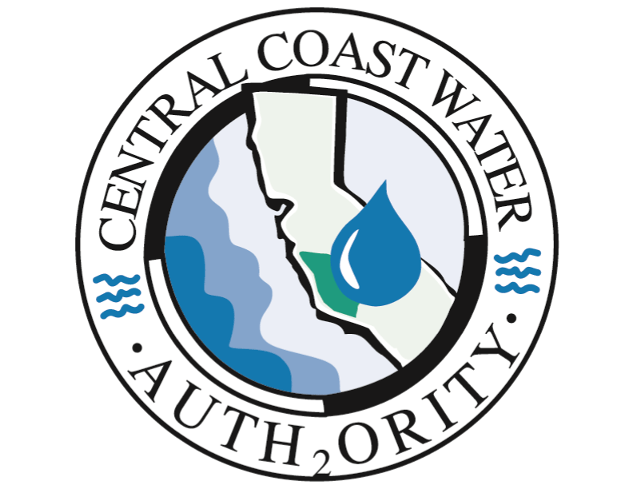
State Water Project Facility Golden Mussel Detection January 23, 2025

Slide 2
Golden Mussel Detection
In October 2024 golden mussels were discovered at Rough and Ready Island near the Port of Stockton
First North American detection and likely introduced via international shipping into the Port of Stockton
SWP facility detections
O’Neill Forebay below Check 12
O’Neill Forebay Outlet at Check 13
Skinner Fish Facility

Slide 3
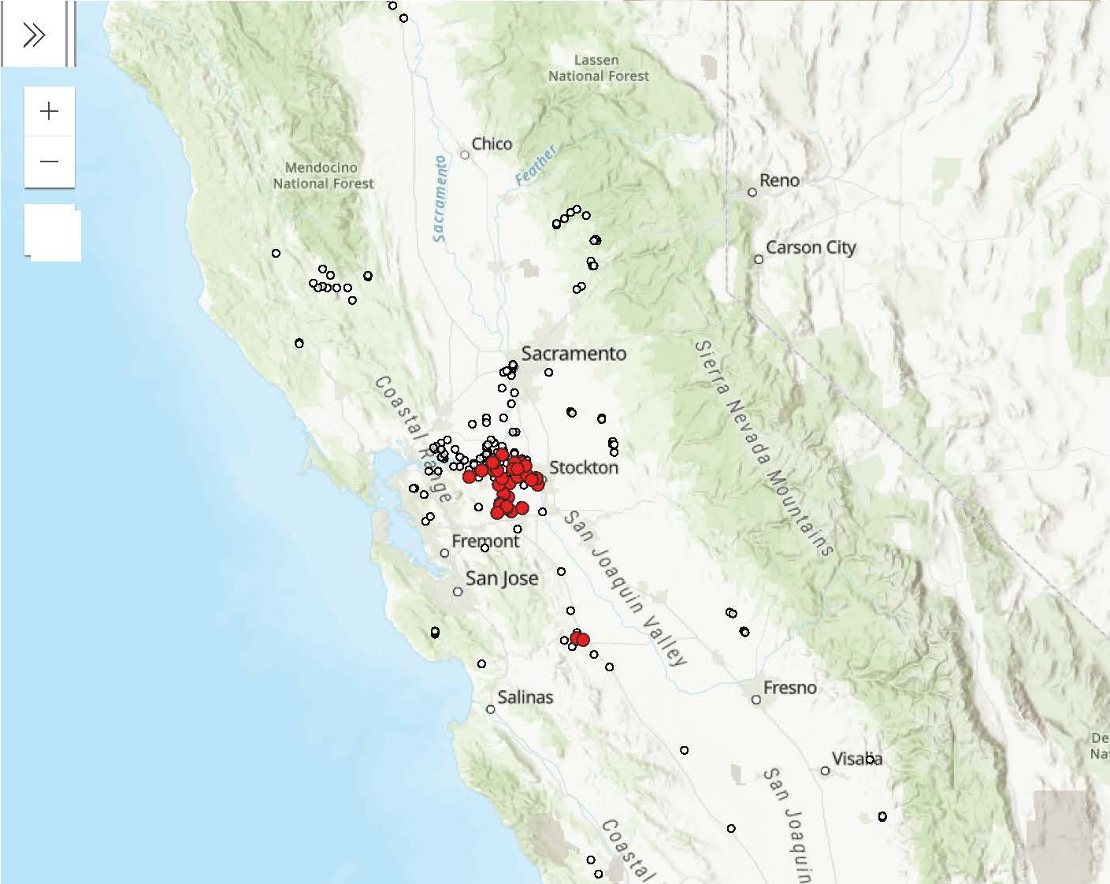
Golden Mussel Detections
January 2025

Slide 4
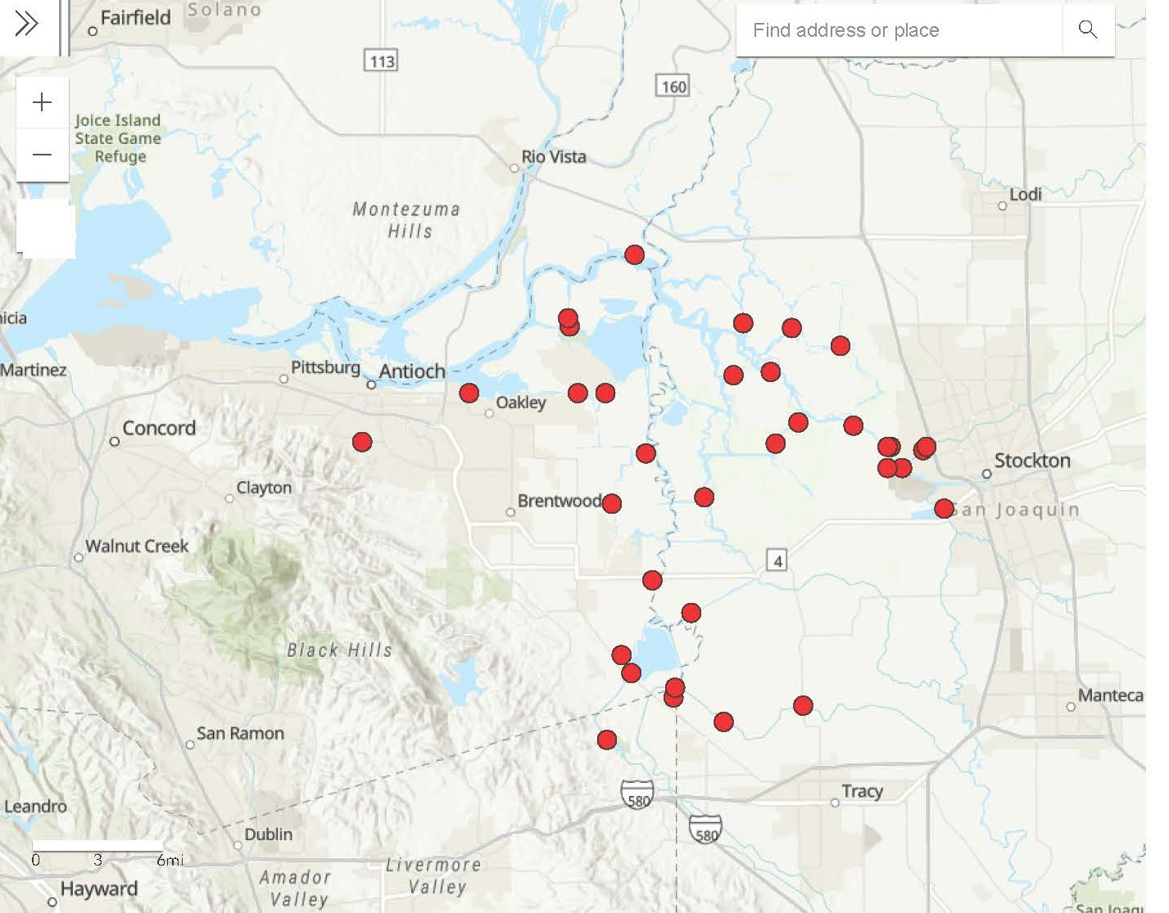
Golden Mussel Detections
January 2025

Slide 5
Golden Mussels
Identified as one of the highest-risk invasive species globally
Similar in biology and impacts as quagga and zebra mussels
Biofouling of infrastructure
Ecological changes
Recreational impacts
Potential distribution
Can tolerate lower calcium and higher salinity than quagga and zebra mussels
All California freshwater lakes and brackish areas of San Francisco Bay Estuary at risk

Slide 6
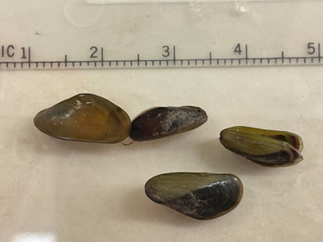
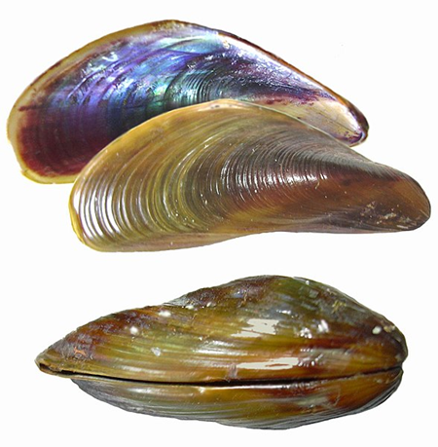
Golden Mussels
Golden Mussel shells collected in October 2024 at a water quality station at Rough & Ready Island near Stockton in San Joaquin County, California, USA. Photo: Elizabeth Wells, Ph. D. (DWR)
Shells of the invasive Golden Mussel (Limnoperna fortunei) showing general morphology (Boltovskoy, 2017).

Slide 7
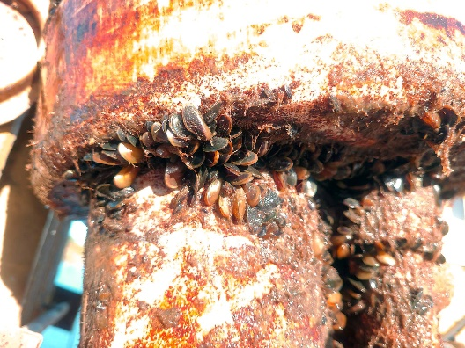
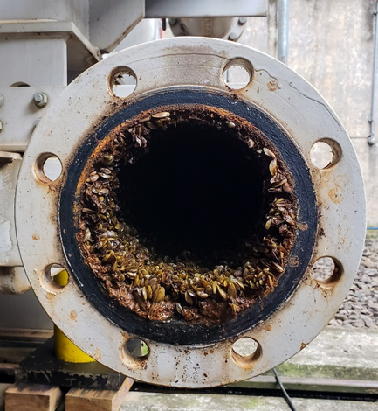
Golden Mussels
Golden mussels colonizing the exterior housing of water quality equipment at Rough and Ready Island in October 2024. Photo: Jay Aldrich (DWR)
Golden Mussels colonizing a water pipe at a hydroelectric plant in Brazil
(Mountinho, 2021)

Slide 8
Response Actions
Golden Mussel Multi-Agency Task Force
State Water Contractor participation
California Department of Fish and Wildlife (CDFW) added golden mussel to restricted species list
CDFW considering amendment to Fish and Game Code 2301-2302
SWP Molluscicide NPDES permit application
Application submitted to Water Board
May use copper, chlorine and/or Zequanox products
DWR O&M Strike Team
Near term and long-term mitigation plans
Initial focus on SWP facilities at O’Neil Forebay and Dos Amigos Pumping Plant

Slide 9
Additional Resources
DWR to develop training materials, sampling protocols and other resources, as needed
CDFW hosting a virtual 2025 Invasive Mussel Water Agency Summit on January 28
CDFW’s online portal
https://wildlife.ca.gov/Conservation/Invasives
/Species/Golden-Mussel

Slide 10
