Slide 1
Water Supply Situation Report
CCWA Operating Committee Meeting
March 14, 2024

Slide 3
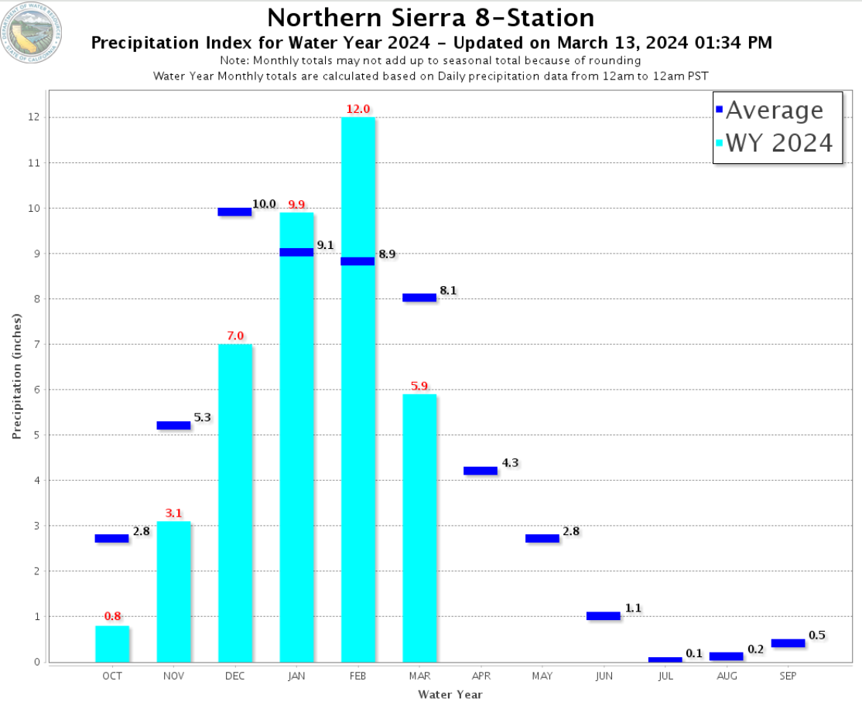

Slide 5
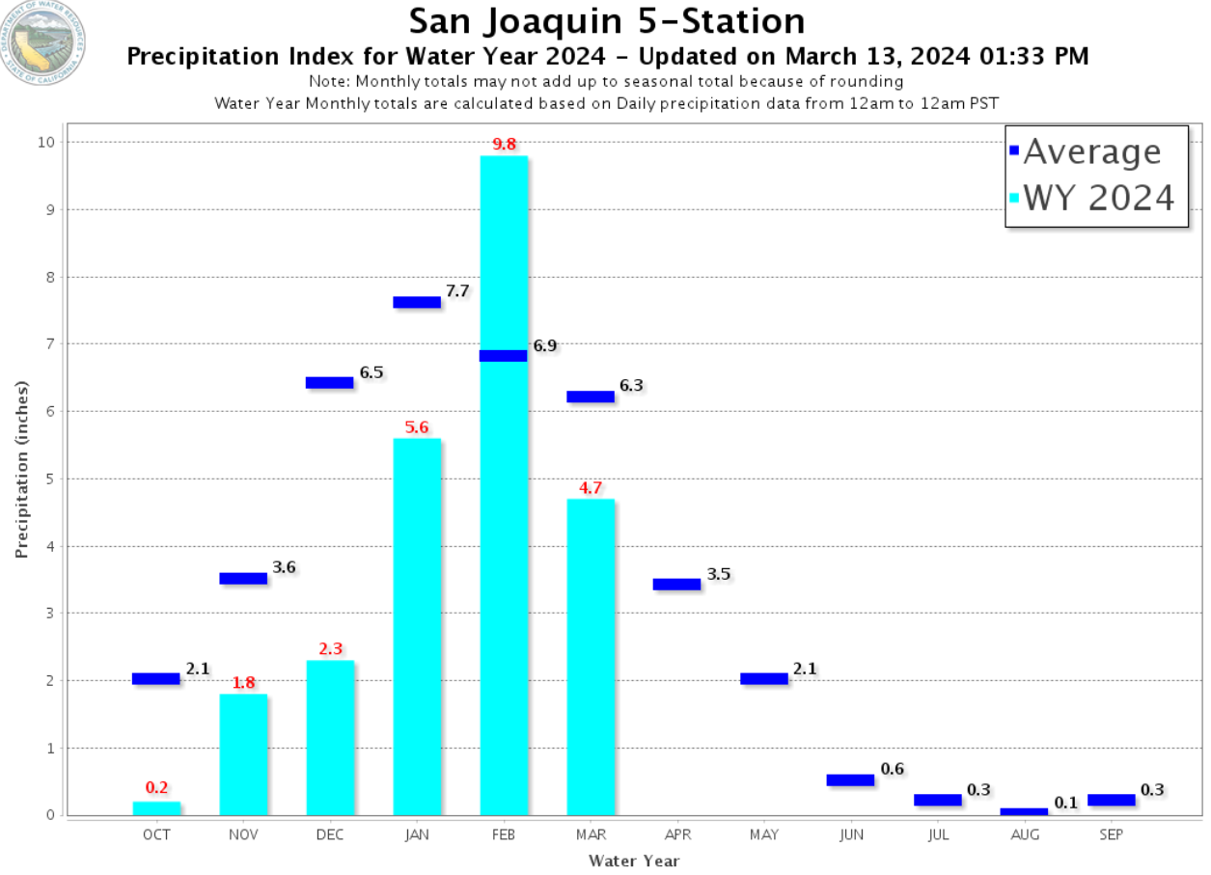

Slide 7
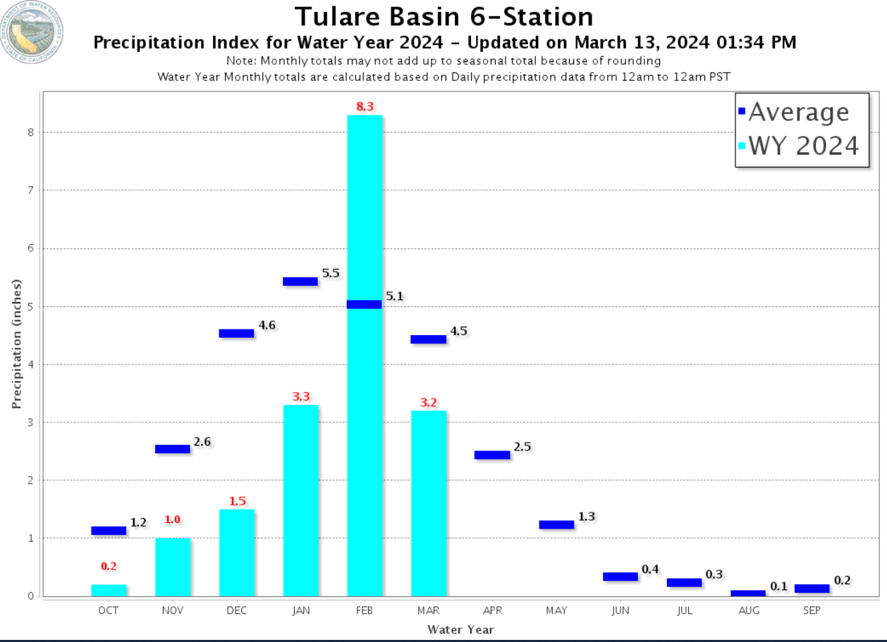

Slide 13
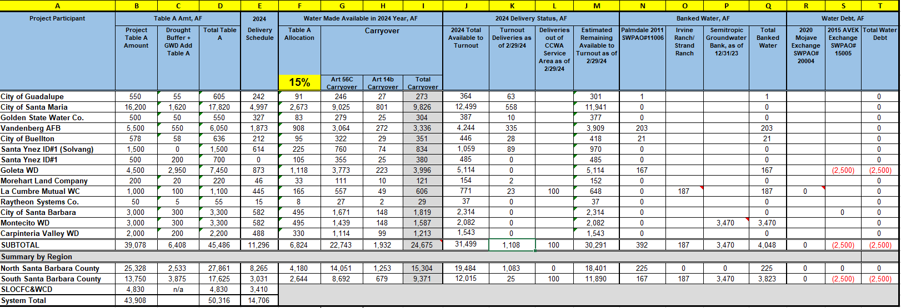

Slide 14
Steelhead and Water Operations
DWR currently limited on pumping potentially through the end of March because of possibly exceeding the take limit for the federally listed Steelhead
To date, the projects (SWP and CVP) have not exceeded the take limit of 2,760, but it is fast approaching (2,600 as of March 1st)
Estimated water loss for the month of March: 40-50 TAF
Under the 2019 NMFS BiOp, NMFS is now the decision maker on Delta water operations.

Slide 15
Questions?

