Slide 1
Water Supply Situation Report
CCWA Board Meeting
February 22, 2024

Slide 3
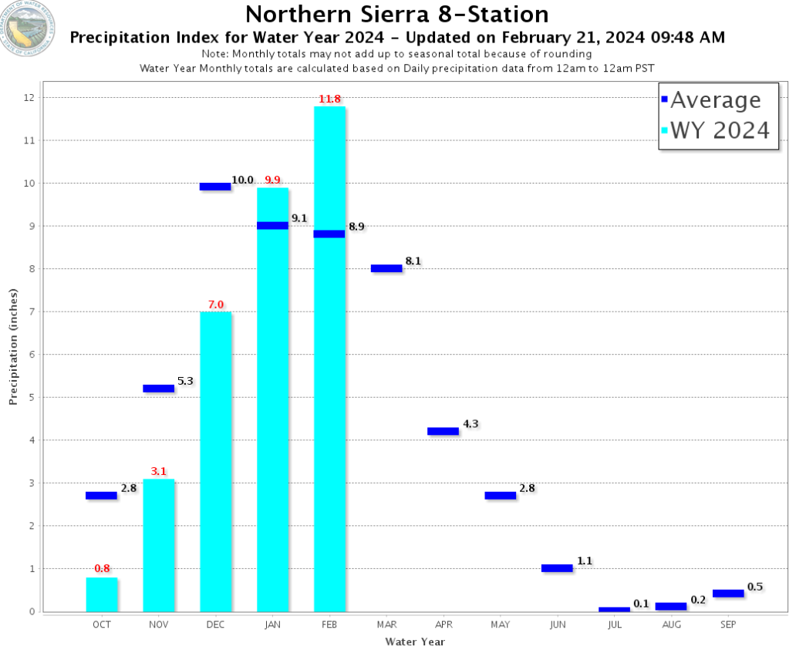

Slide 5
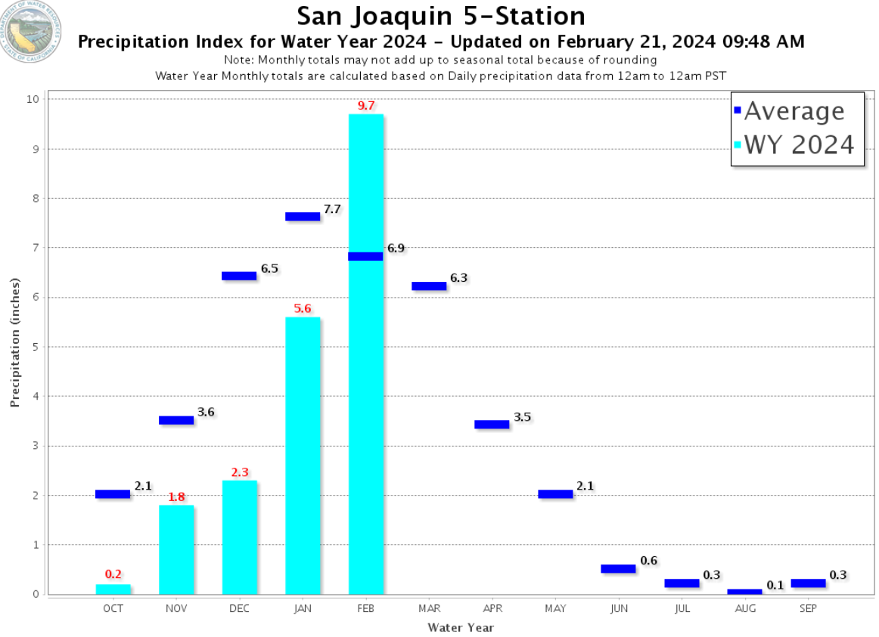

Slide 7
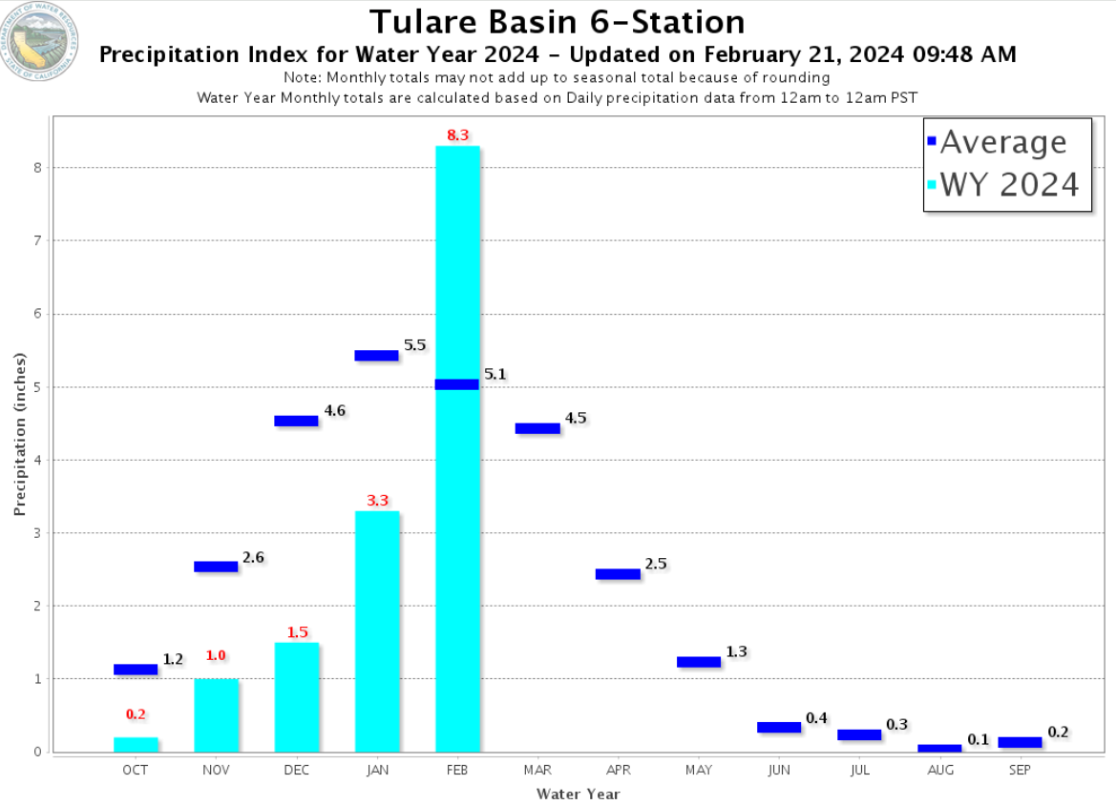

Slide 14
Questions?

