Slide 1
Central Coast Water Authority
Operating Committee Meeting
March 2024

Slide 2
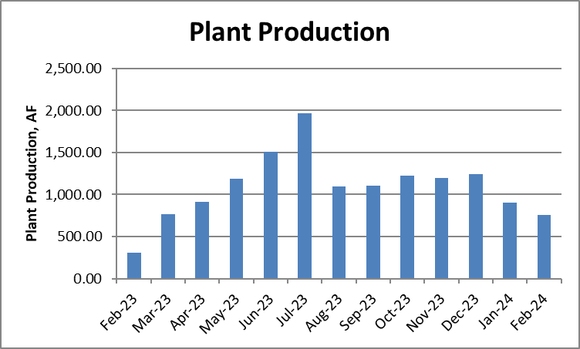
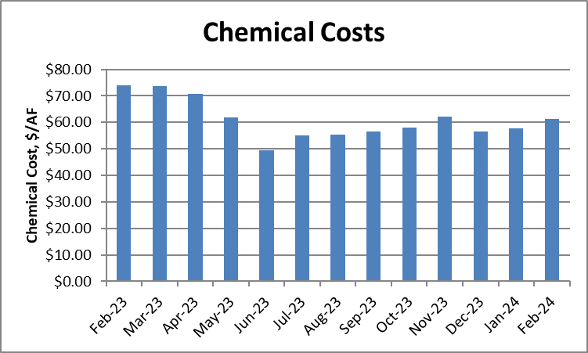
PLANT PRODUCTION, CHEMICAL COSTS AND LAKE CACHUMA PUMPING
 | Plant Production (AF) | Chemical Costs ($/AF) | SYPF Pumping (AF)
January 2024 | 904.99 | $57.85 | 25.06
February 2024 | 757.80 | $61.17 | 0

Slide 3
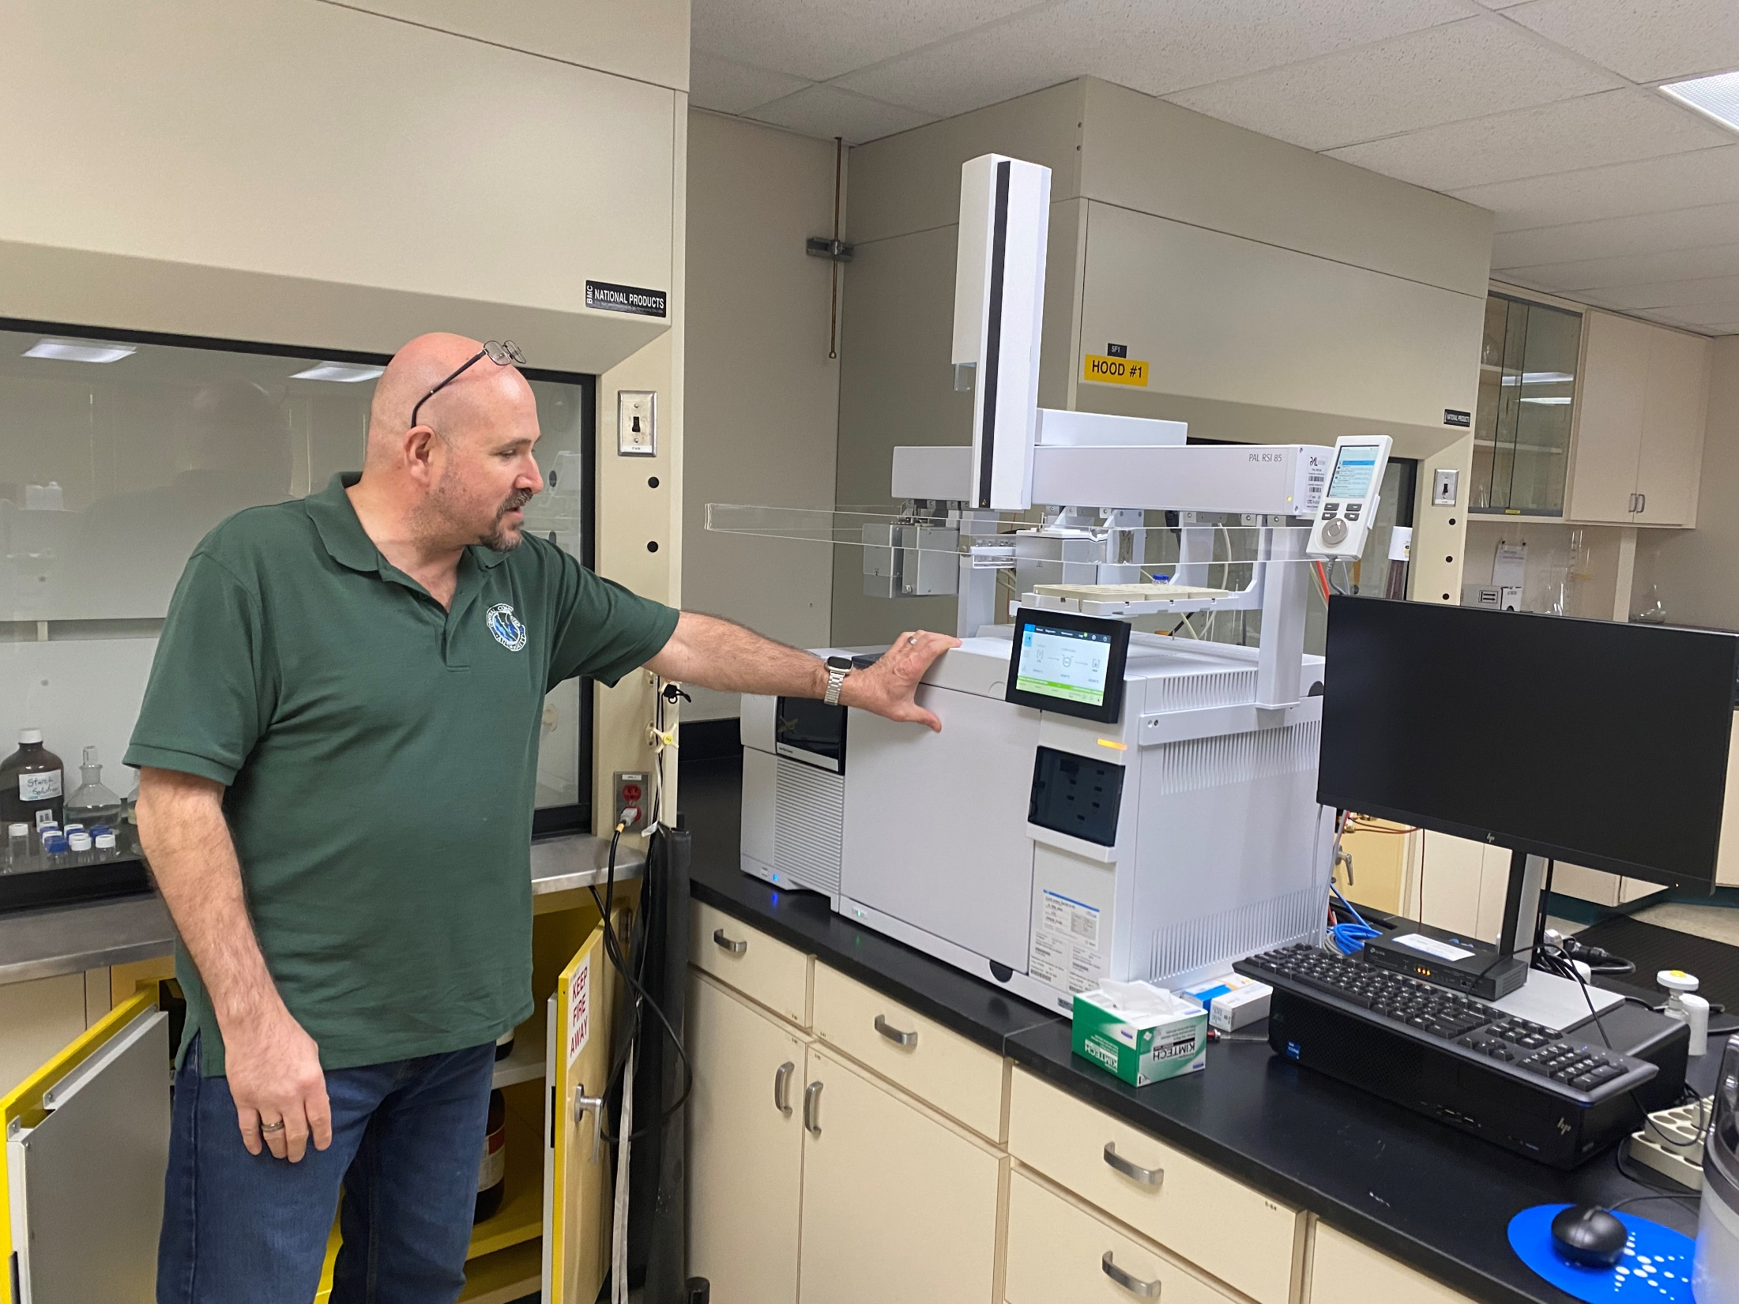
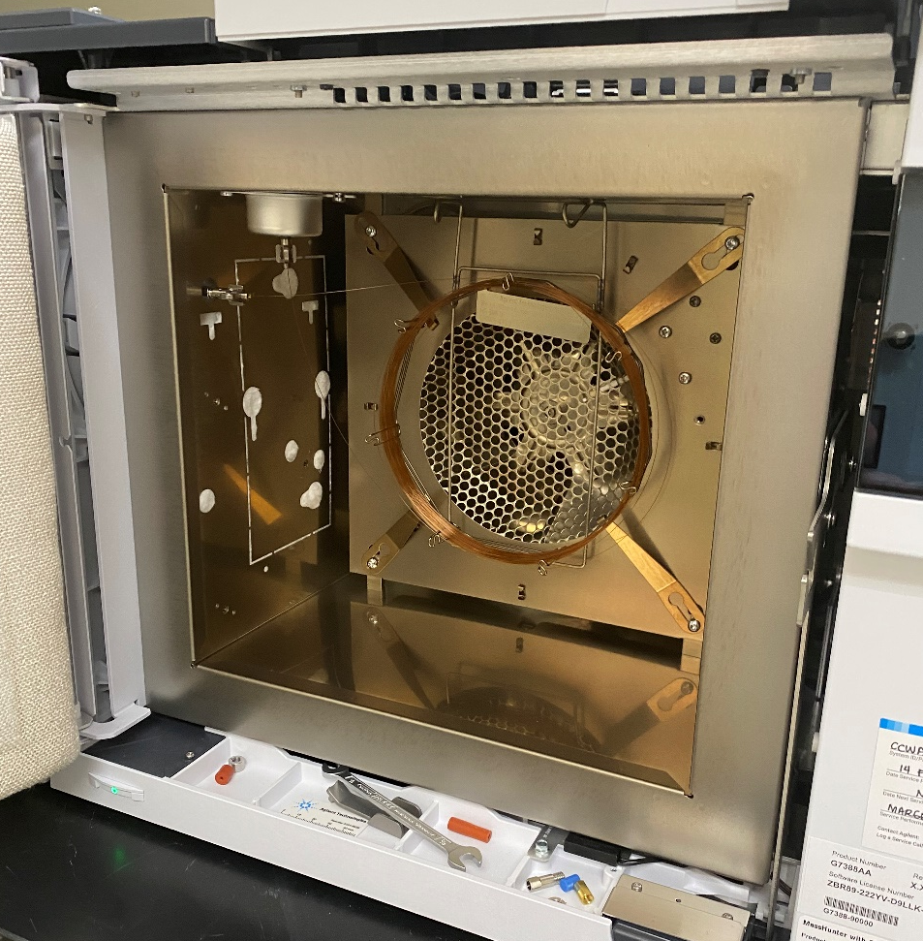
Gas Chromatography/Mass Spectrometry Instrument
for MIB/Geosmin Analysis

Slide 4
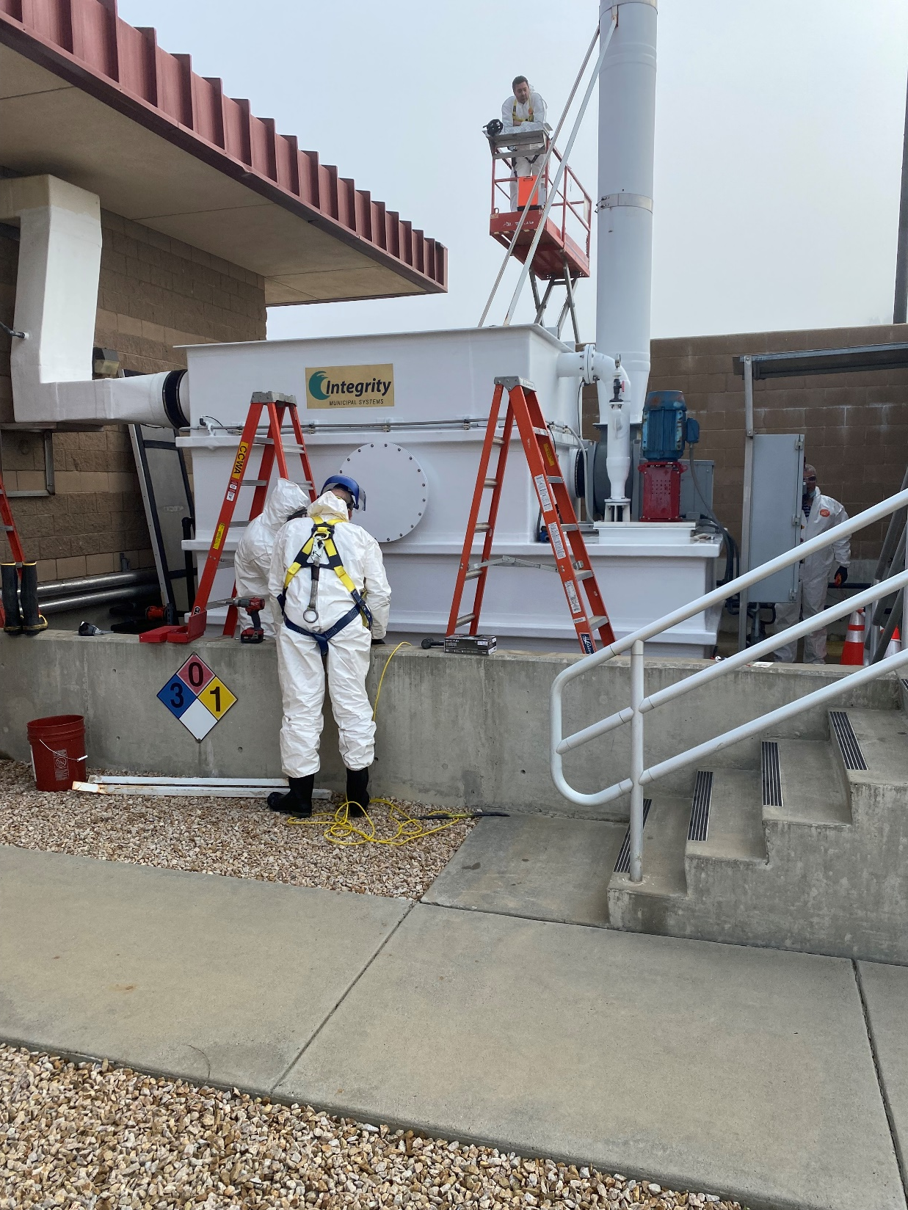
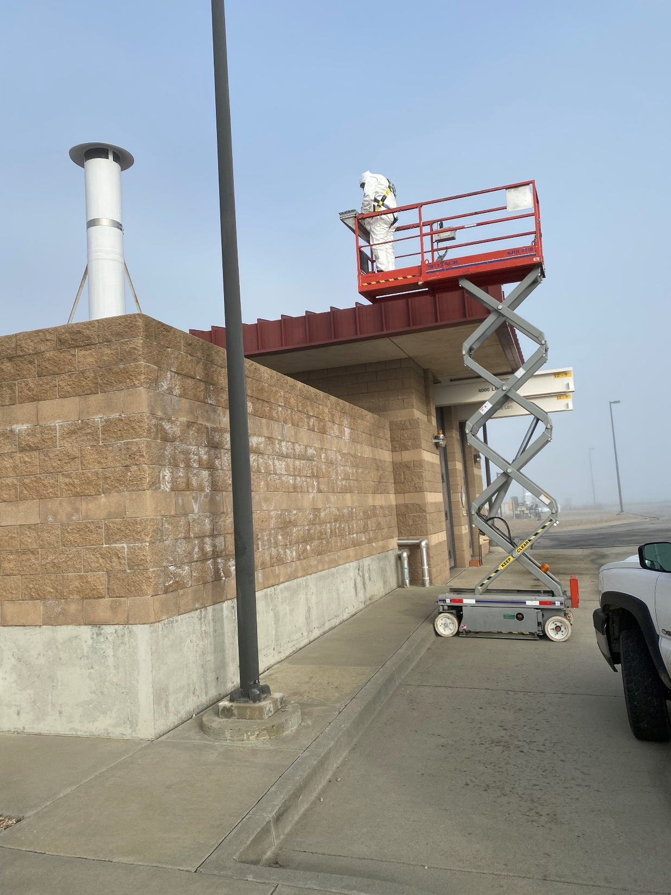
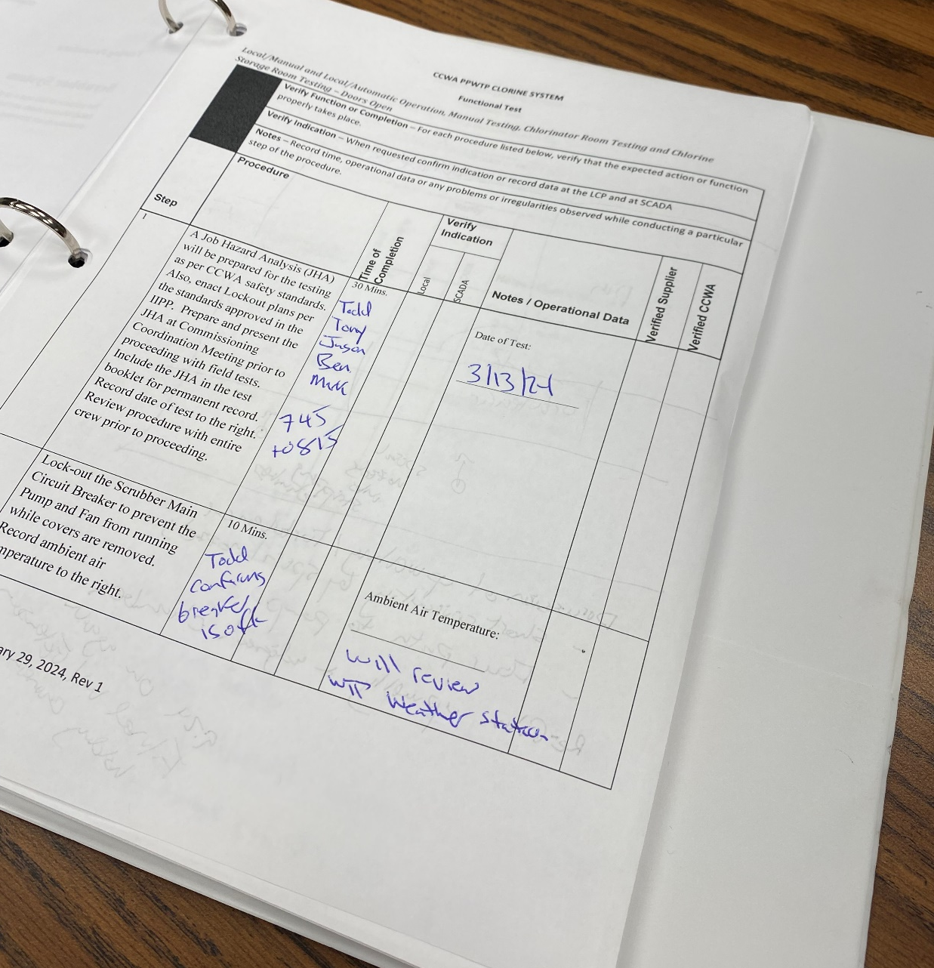
Chlorine Scrubber Investigation – Caustic Emission Incident January 17, 2024

Slide 5
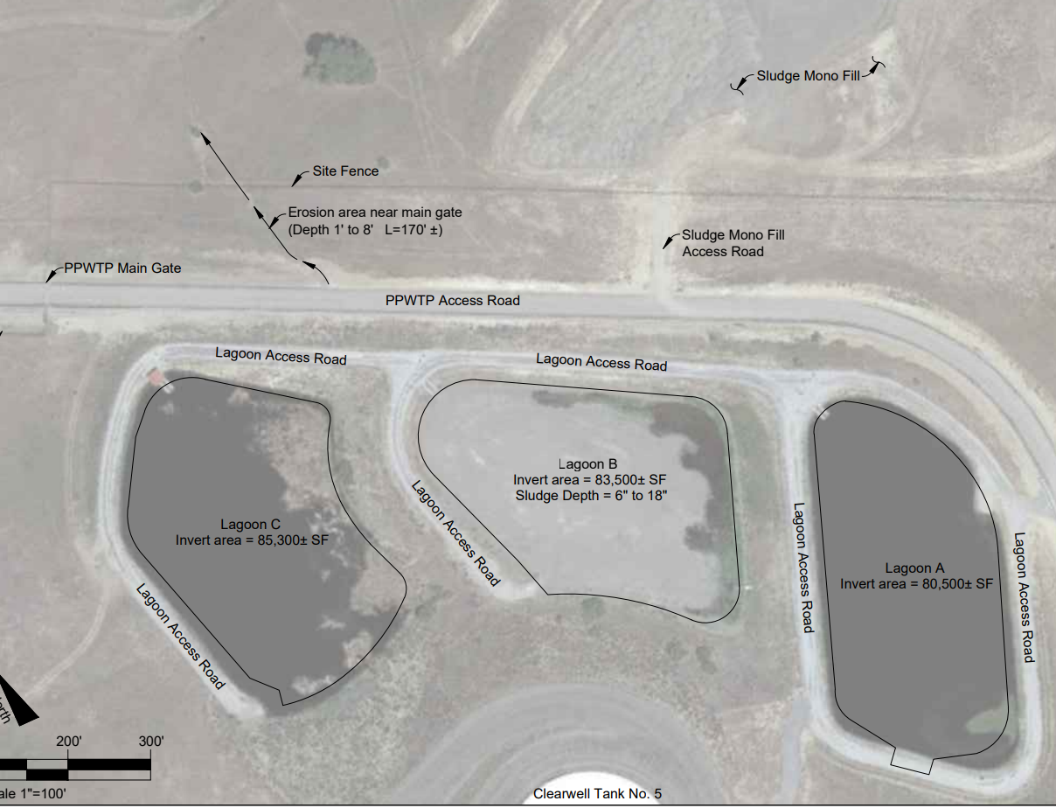
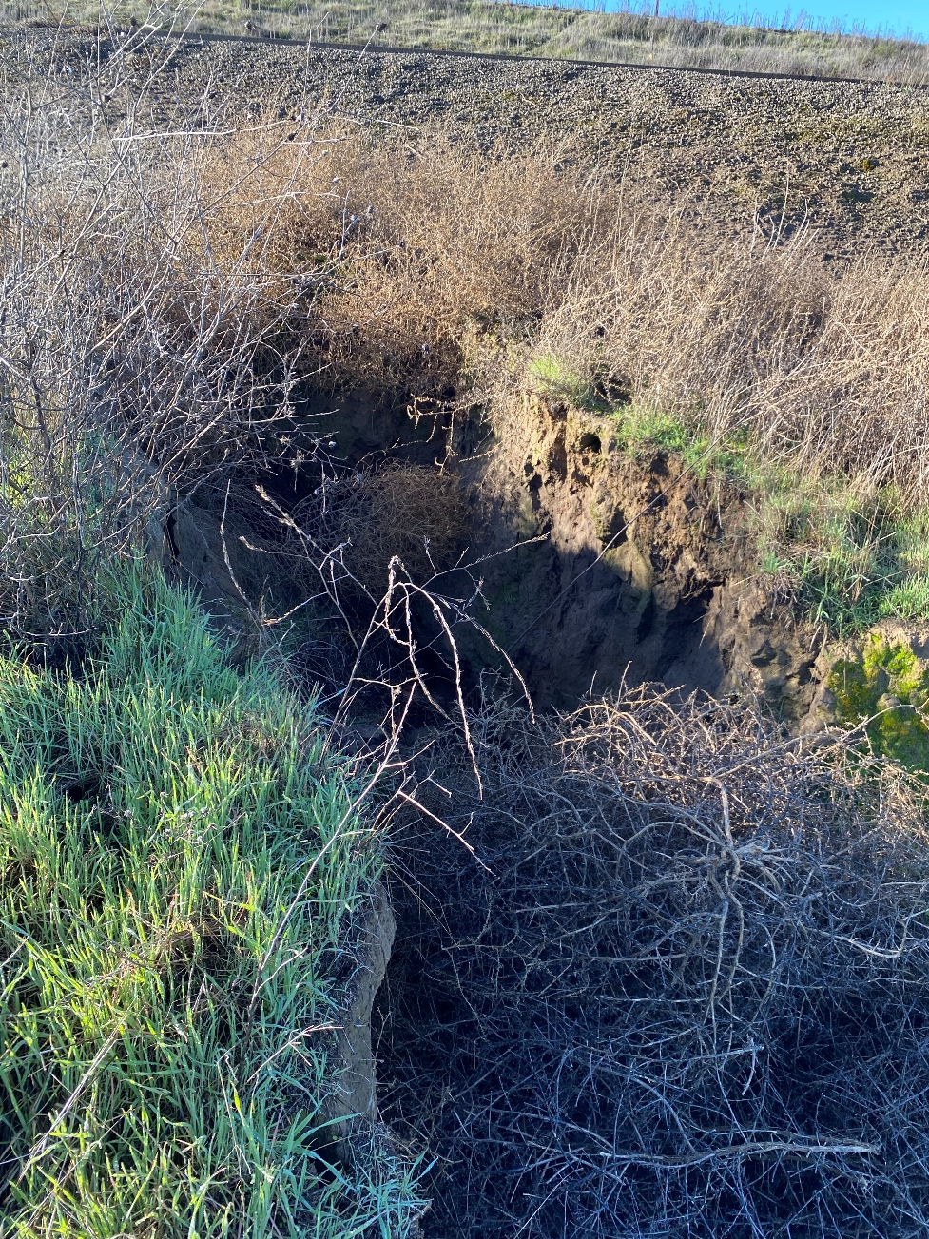
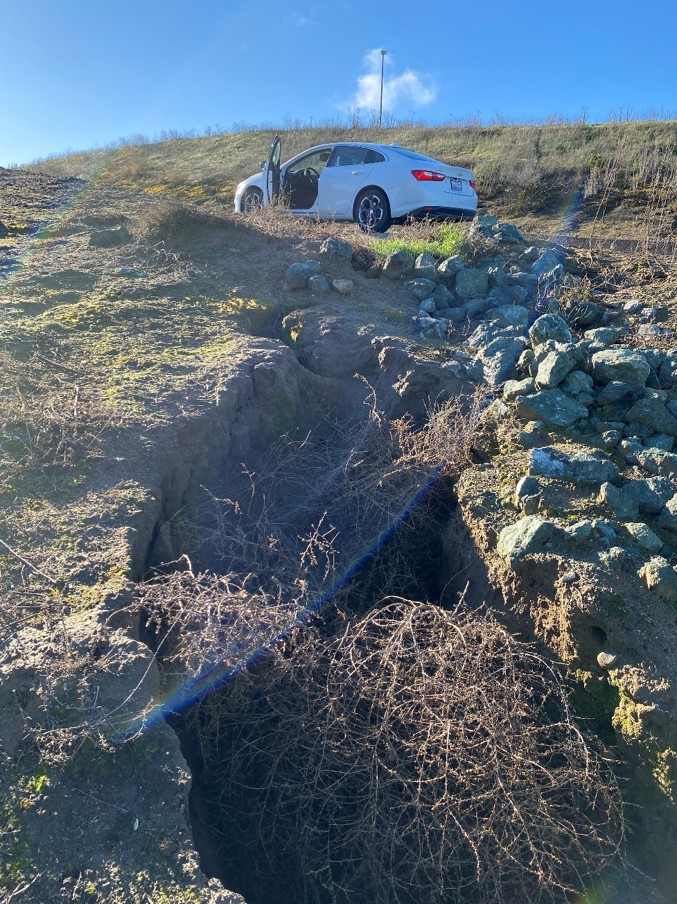
Water Treatment Plant Main Gate Erosion Repair

Slide 6
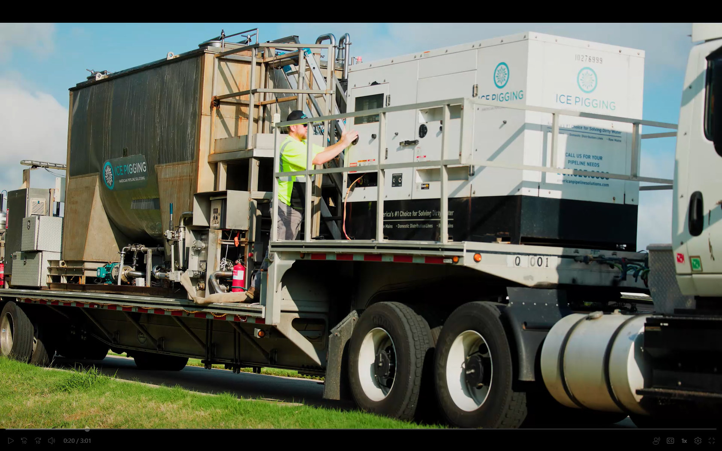
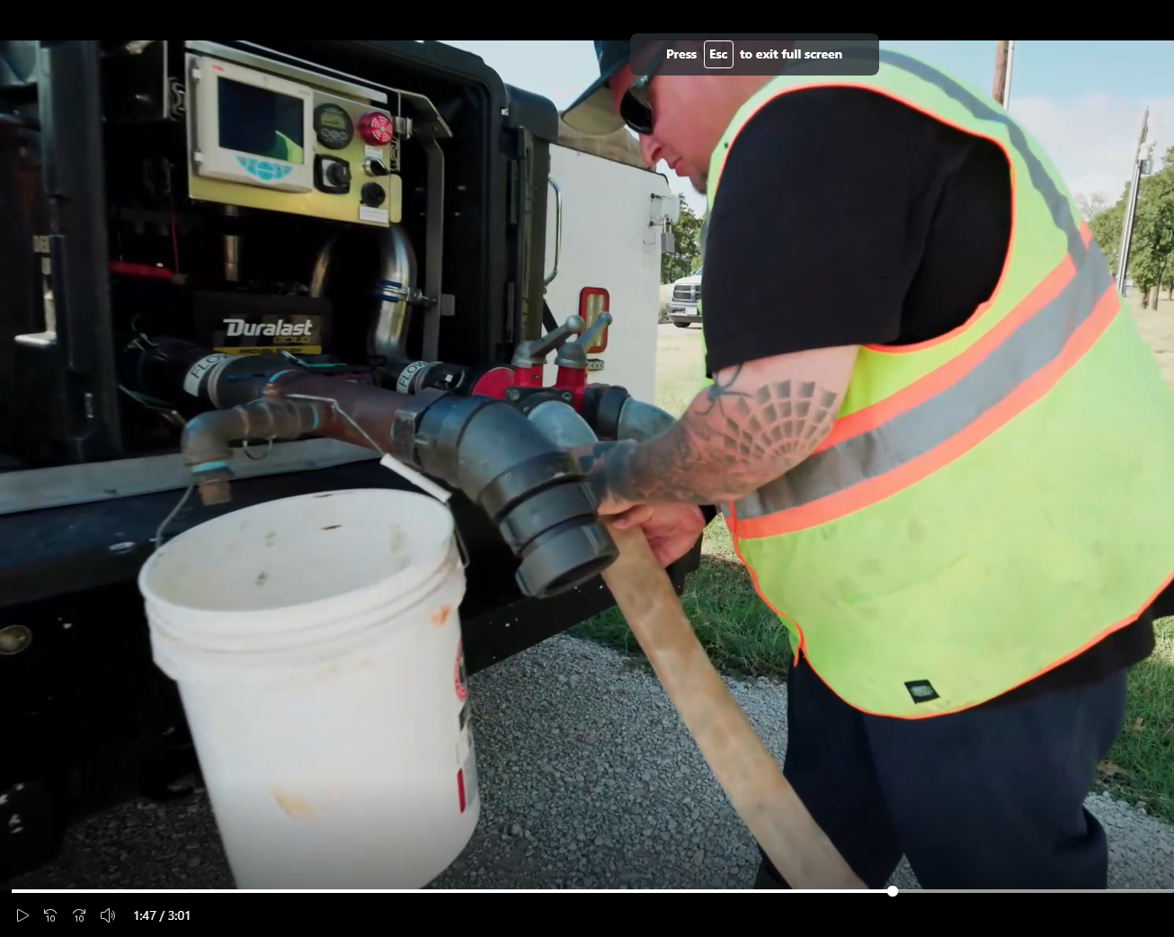
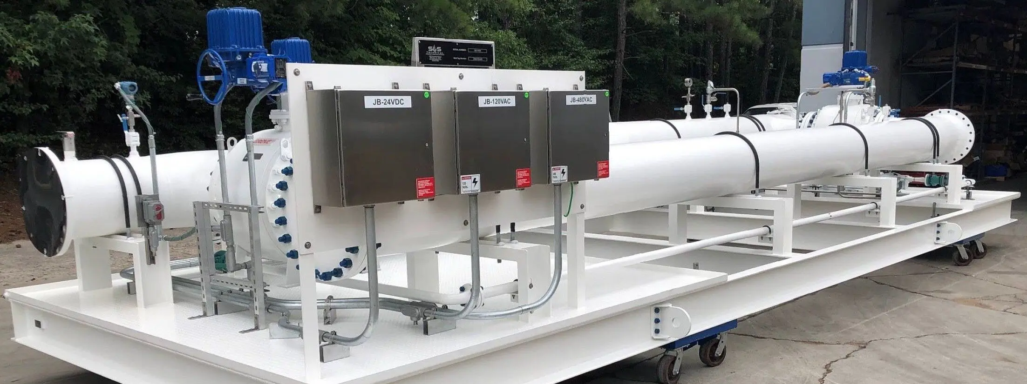
Next Step Nitrification Control: Pipeline Pigging

Slide 7
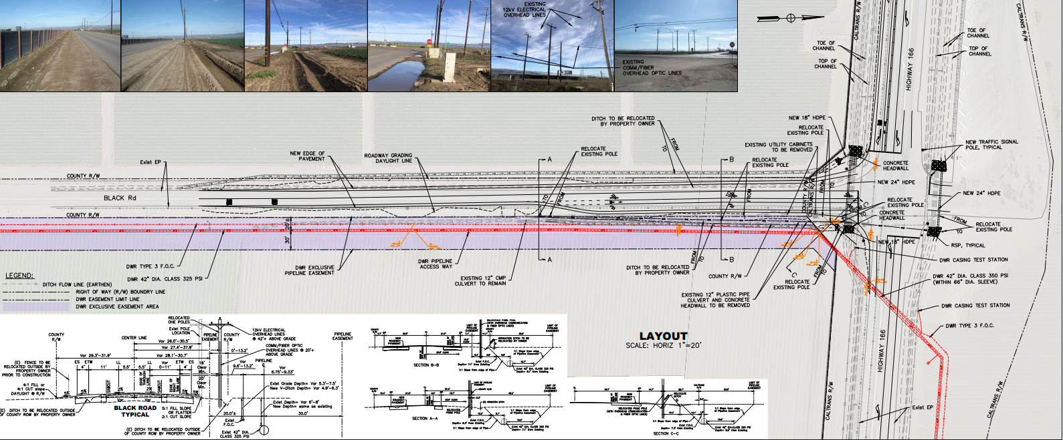
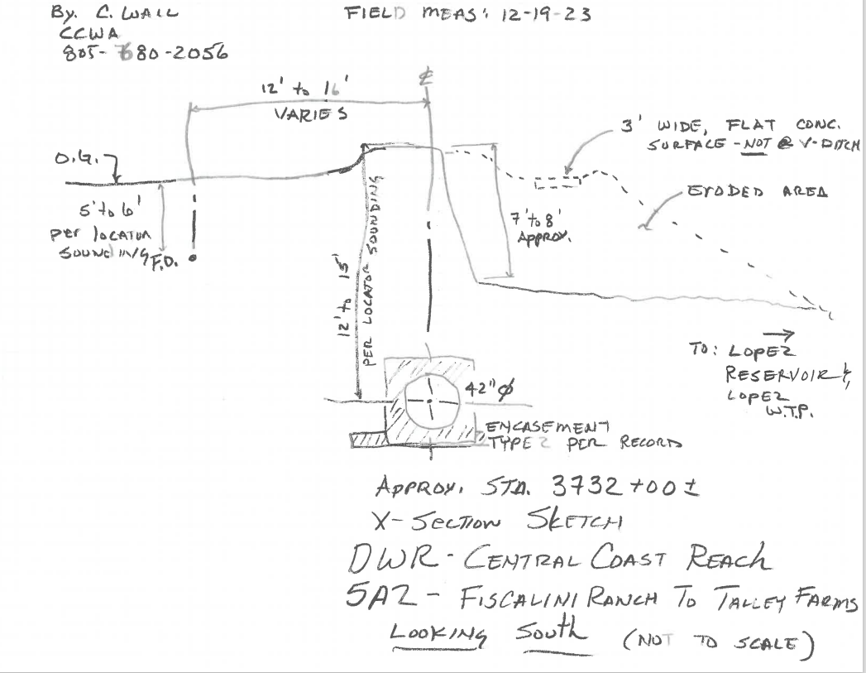
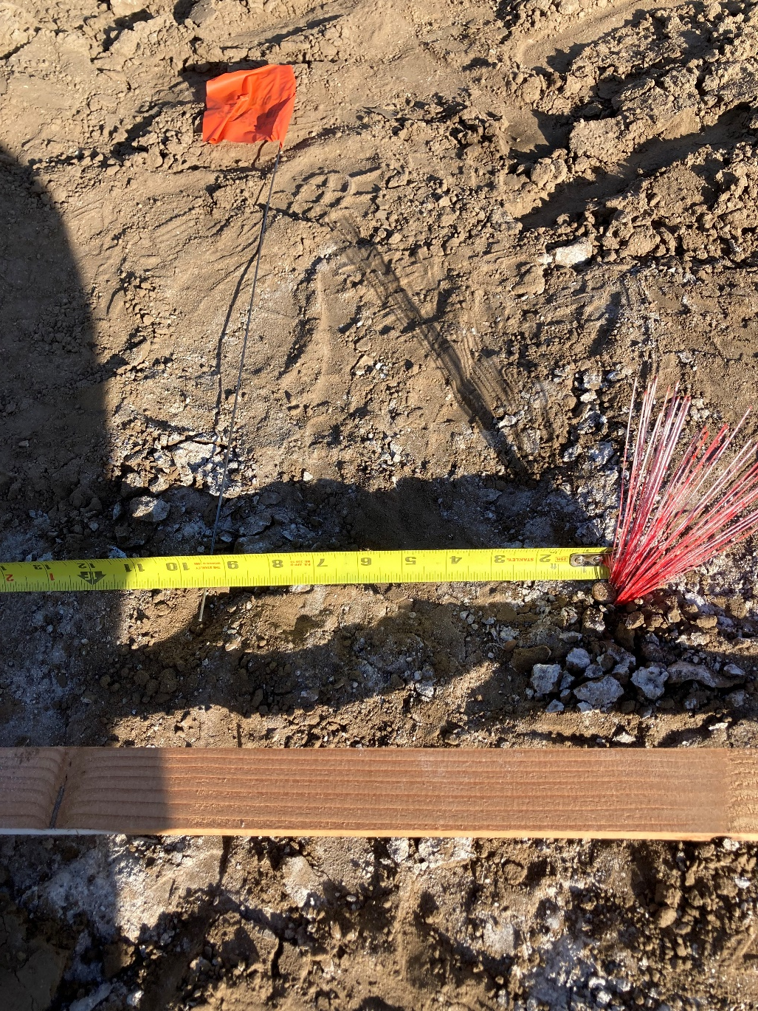
Encroachment Issues

Slide 8
General Items
Design Work
WTP Office Design – On Hold
SYPP Surge Tank Pedestal – Going out to Bid
Tank 5 Inlet Chloramination Station – Going out to Bid
Lining of Lower Containment of Chemical Tank Farm – Going out to Bid
Environmental Compliance
Inspection of Tank 5
Air Pollution Control District Annual Report for Generators
Tank 5 Hazardous Waste Disposal Complete.
Management of Change Process For Chlorine Scrubber.
Potential Red Legged Frog Response
Staff Changes
WTP Operator Trainee – Made Job Offer
WTP Supervisor Retired – DDW Notified, Interim Assigned, Recruitment Underway.
Deputy Director Retiring – Recruitment Underway

